Slide 1




Astronomy 1020 chapter 27
Clayton State University
Slides for Astronomy textbook from OpenStax
https://openstax.org/books/astronomy/

Slide 2
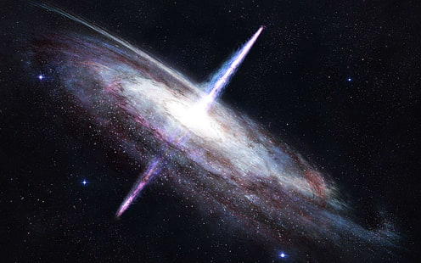
Active Galaxies, Quasars, and Supermassive Black Holes

Slide 3
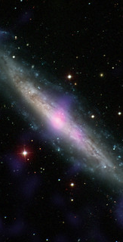
Active Galactic Nucleus
The centers of galaxies are found to be
1. a dense stellar cluster, with composite stellar-type absorption and emission spectra
2. extremely bright and compact nucleus, sometimes brighter than the entire galaxy, with non-stellar spectra
The second type are the AGN, up to 10% of all galaxies, possibly an active phase of all galaxies
AGN have strong, broad and rapidly variable emission lines from hot gas – the nuclei are a few light-days across !

Slide 4
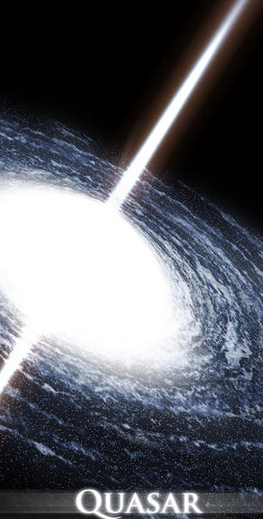
Active Galactic Nuclei and Quasars
Centers of galaxies are extremely bright and active; due to super-massive black holes at the center
Emit light strongly in ALL wavelength bands, from gamma rays and X-rays to Radio
The spectra do NOT look like that of stars – evidence of unusual non-stellar activity
Quasars: Quasi-Stellar Radio Sources, appear star-like owing to large distances and red-shifted spectra
Hence QSO’s were formed early in the Universe, and are otherwise also active galactic nuclei (AGN)

Slide 5
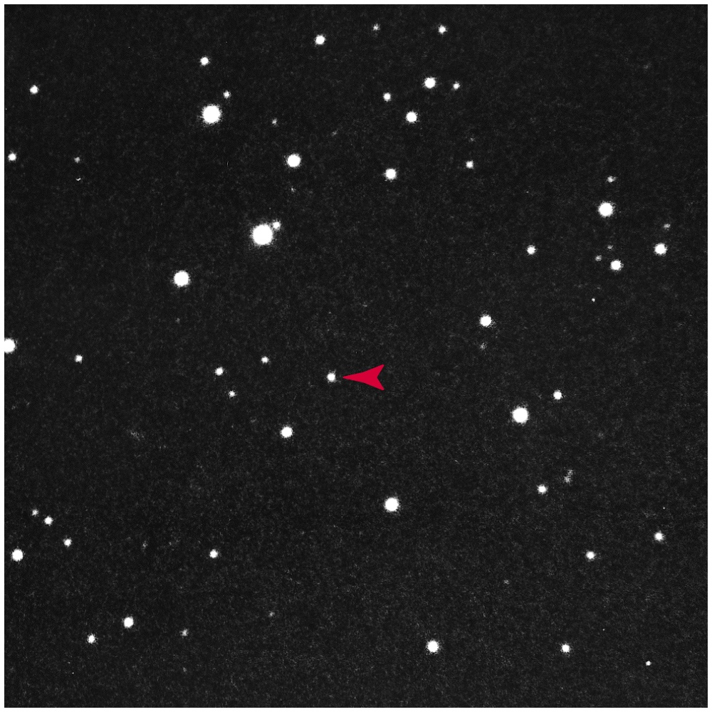
Quasar

Slide 6
AGN –Seyfert Galaxies
Spiral galaxies with bright compact nuclei showing broad emission lines like quasars are called Seyfert galaxies (after Carl Seyfert)
Broad emission lines are due to Doppler broadening of light from gas clouds moving at high velocities, about 10,000 Km/sec
Radiation from AGN and Quasars indicates a plasma source with temperatures 100,000 to millions of degrees (stars have temperatures much less than 100,000 K)
How does the Black Hole power AGN and quasars ?

Slide 7
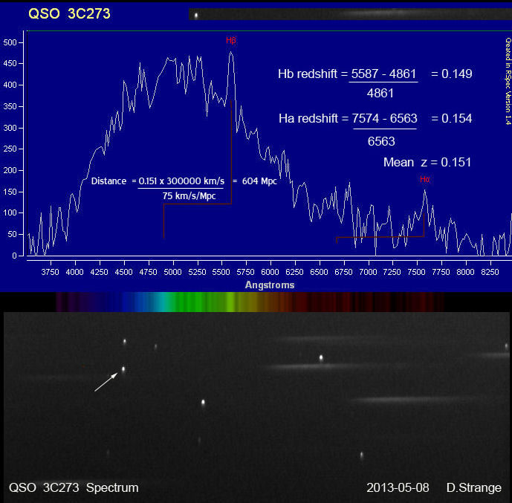
Blackbody Stellar vs. Non-thermal AGN Spectra
Stellar spectra are that of a blackbody (BB) with peak emission around in one wavelength region
AGN and Quasar spectra are non-thermal (non-BB), with radiation flux decreasing monotonically with frequency (energy), but remains significant at all wavelengths
This Photo by Unknown Author is licensed under CC BY

Slide 8
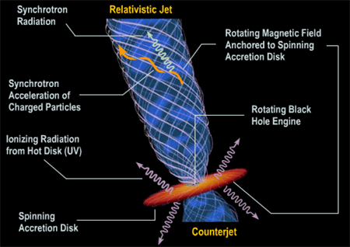
Active Radio Galaxies
Radio loud: powerful radio sources
- Low Power: Radio galaxies
- High Power: Quasars
Radio Quiet: weak radio sources
- Low Power: Seyfert galaxies
- High Power: quasi-stellar radio sources
Radio sources have jets of relativistic particles due to magnetic acceleration, and large “lobes”
Jets of high-velocity charged particles emit radio waves called “synchrotron radiation”

Slide 9
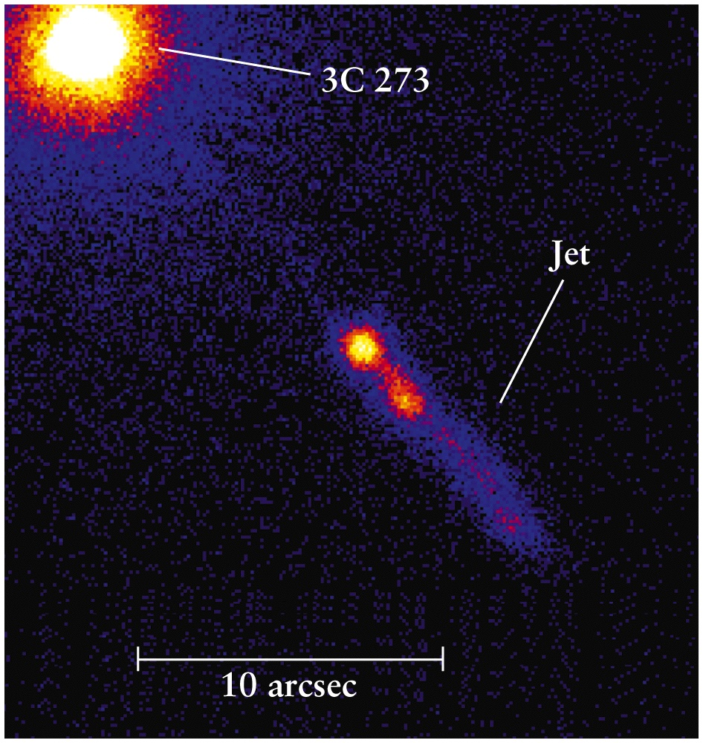
Quasar 3C273 and Relativistic Jet

Slide 10
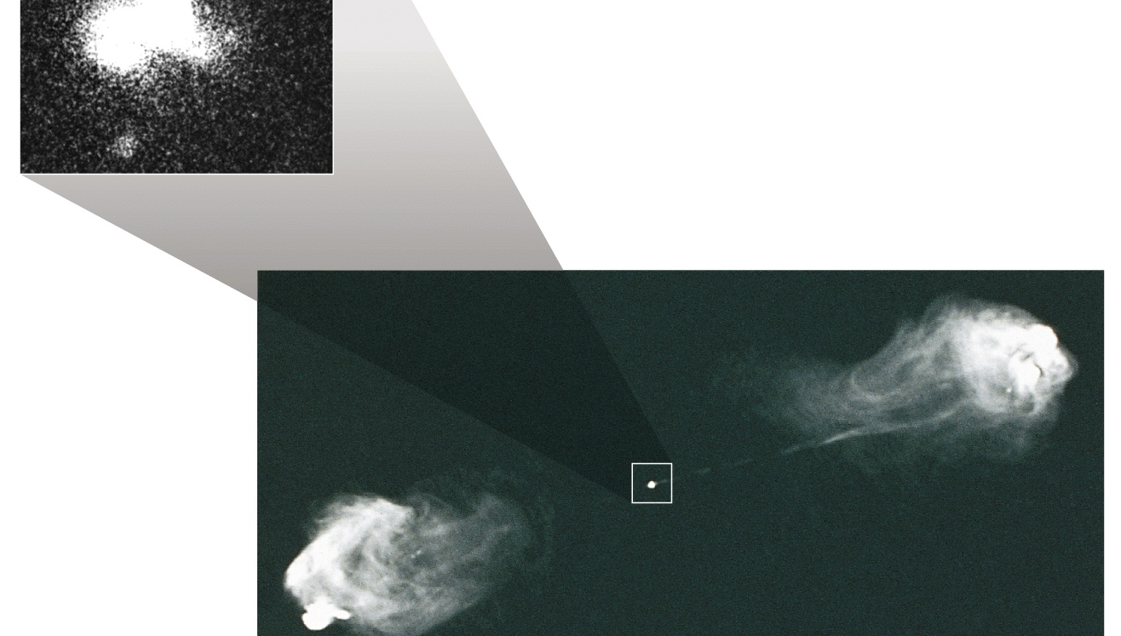
Radio lobes at endpoints of jets

Slide 11
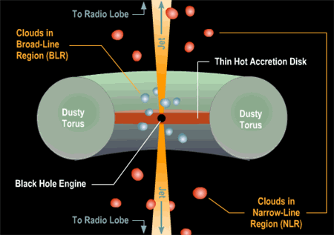
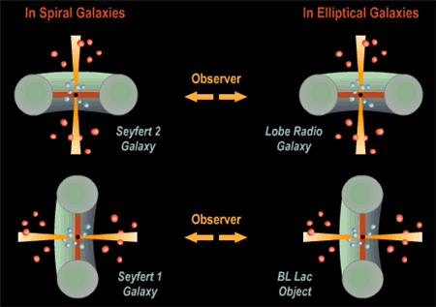
Supermassive Black Hole Paradigm:
Structure of AGN and Quasars
Geometry of AGN/Quasars : Black Hole surrounded by an accretion disc, embedded in a torus (doughnut shaped), with jet streams perpendicular to the disc
High velocity clouds moving around, with Doppler broadened emission lines
Orientation of disc determines our view:
- face on looking at the nucleus OR
- edge-on view of the obscuring torus
Most extreme Quasars : BLAZARS (BL Lac objects), viewing the jets end-on, no emission or absorption lines, but surrounding elliptical galaxies seen as “fuzz”

Slide 12
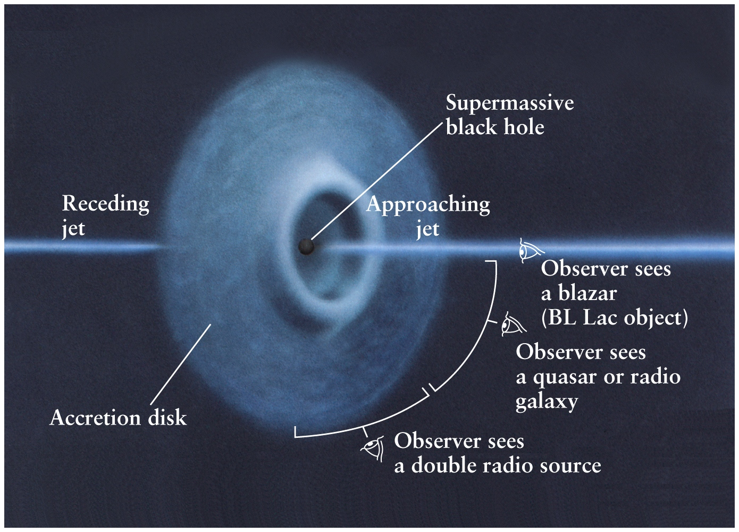

Slide 13
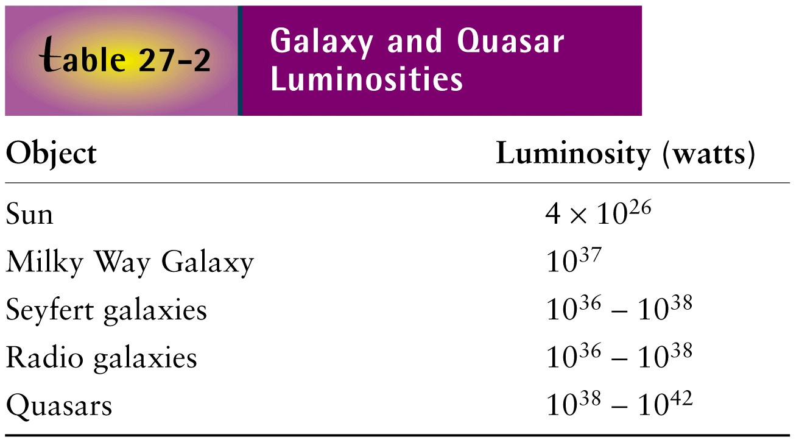
Comparative luminosities

Slide 14
Evolutionary Sequence of Galaxies
Quasars are nuclei of active galaxies in the distant past: ultra-luminous, high-z objects
AGN are the link between quasars and normal galaxies, activity continues to present day as they evolve
Quasar/AGN activity fueled but a super-massive black-hole (SMBH) engine
All galaxy formation may be driven by SMBH activity during some epoch

Slide 15
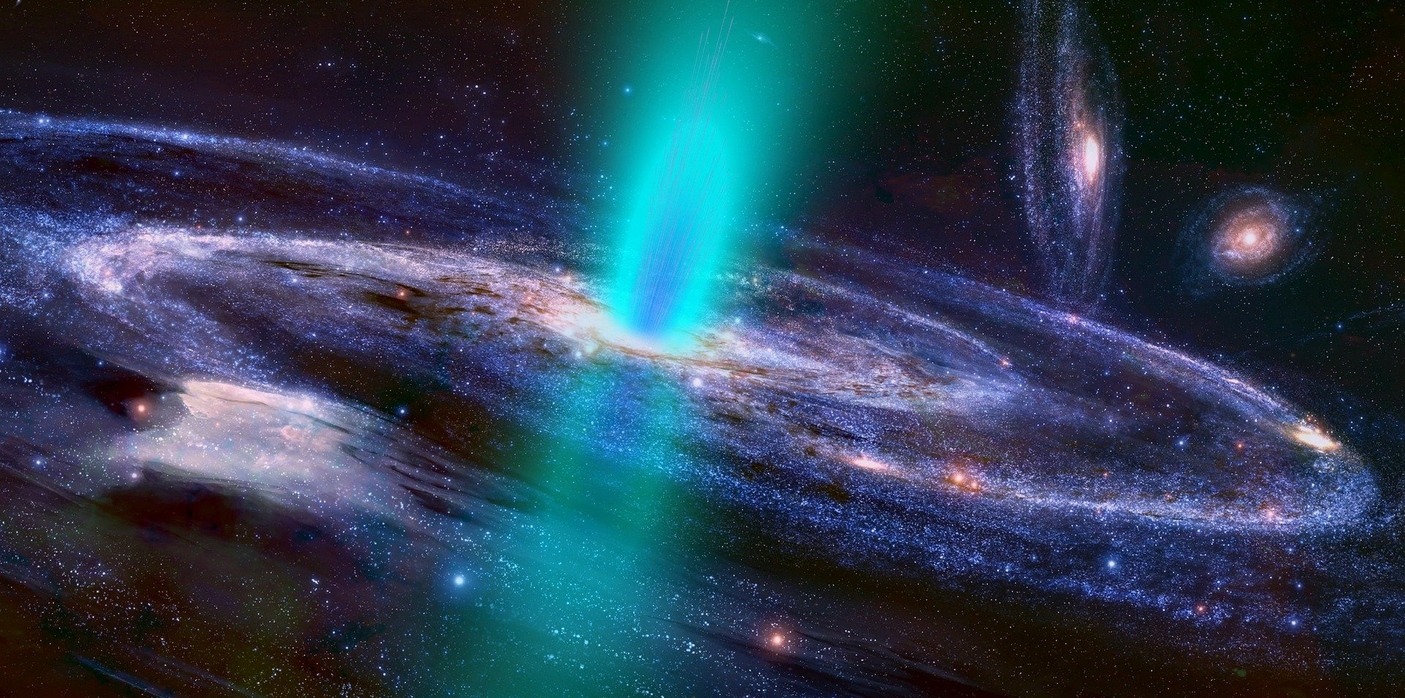
Any Questions?
A depiction of a quasar/AGN

